Slide 1
Family member and friend treatment for gambling harm: Development of a self-directed intervention
Dr Stephanie Merkouris
School of Psychology, Deakin University
stephanie.merkouris@deakin.edu.au
September 20, 2023
AFINet Webinar Series

Slide 2
Scoping review of affected other gambling literature Research team: - Prof Nicki Dowling, Dr. Chloe Hawker, Dr. Stephanie Merkouris (Deakin University) - A/Prof Simone Rodda (Auckland University of Technology) - Prof David Hodgins (University of Calgary)

Slide 3
The Research Aims
To examine contemporary research relating to addressing gambling harm to adult affected others, in relation to the:
Prevalence of affected others
Socio-demographic profiles of affected others
Harms experienced by affected others
Coping strategies employed by affected others
Assessment of affected others
Interventions for affected others

Slide 4
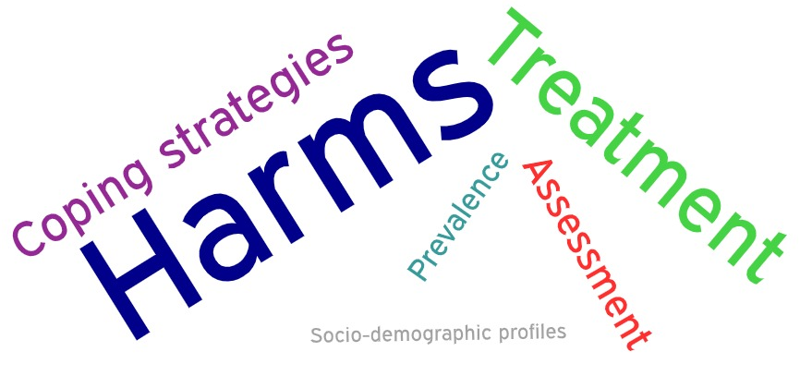
Overall Mapping of Literature

Slide 5
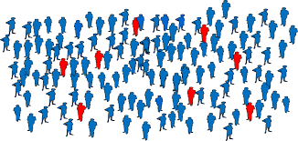
Prevalence (9 studies)
Gambling-related harm extends beyond intimate partners to family members and friends
The prevalence of affected others in the population ranges from 2-19%
The gambling problem of one individual has direct negative effects on at least six others; and low-risk and moderate-risk gamblers affect one and three others, respectively
Based on very limited longitudinal research, affected other status appears relatively labile across time, with improvement across a range of domains

Slide 6
Socio-Demographic Profiles (4 studies)
The socio-demographic profiles of affected others are little studied
Mixed findings in relation to sex, age, marital status, and education, likely due to different definitions of affected other status
Single studies: living in a city, being a male immigrant, living on social welfare

Slide 7
Harms (62 studies)

Slide 8
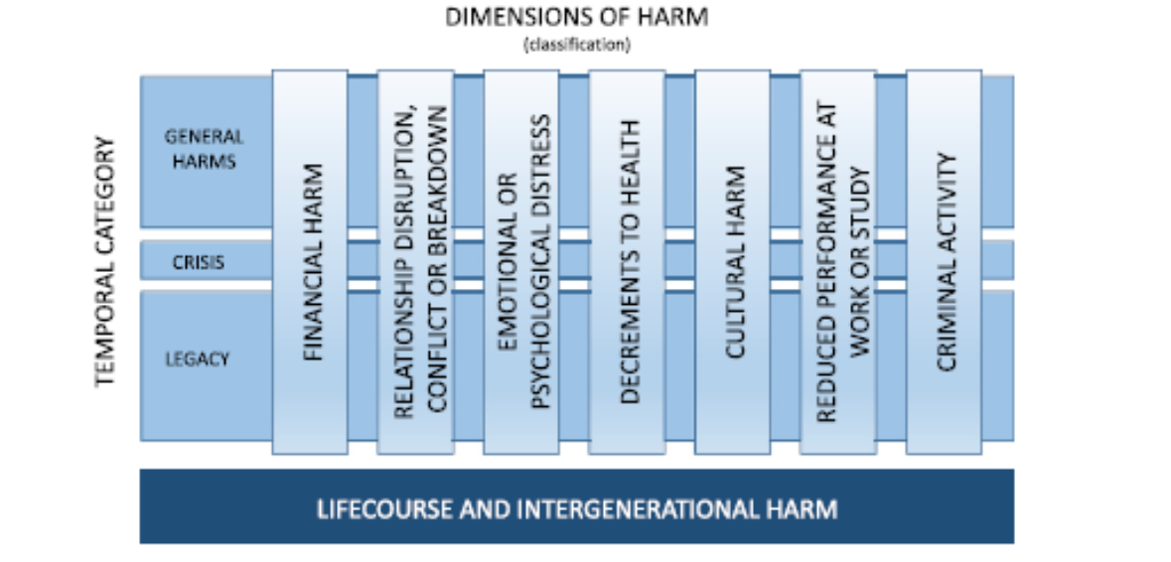
Types and Extent of Harm

Slide 9
Study Designs
QUANT – DIRECT
Have you felt depressed because of another person’s gambling?
Usually single items
QUAL – DIRECT
Have you felt depressed because of another person’s gambling?
Usually in interviews or focus groups
QUANT - INDIRECT
Have you felt depressed?
Compares AOs and non-AOs on general measures of depression
Usually uses standardised measures

Slide 10
Types and Extent of Harm: Main findings
Intimate partners report an initial lack of awareness about gambling problems
The types of harm were largely consistent with the taxonomy
Studies employing a range of study designs and affected other sample types consistently revealed that affected others reported harm with and without direct reference to gambling across all seven domains of the harm taxonomy
Equivocal findings most evident in research employing standardised measures that did not directly reference gambling

Slide 11
Burden and Concordance: Main findings
Burden of harm
The quality of life of affected others was decreased by 10 to 36%
Affected also report slightly lower, but non-negligible, estimates when gamblers had lower risk problems (17% for low-risk gambling and 33% for moderate-risk gambling)
Concordance in harms reported by gamblers and affected others
Although studies examining the concordance in harm reported by gamblers and affected others demonstrated mixed findings, there was some evidence of discordance in terms of the number, severity, and types of harm
Gamblers with problems across the risk continuum estimate their gambling affects fewer people than affected others

Slide 12
Assessment (15 studies)
Construct assessed | Name of measure
Assessment of affected other status | Unvalidated single items
 | Lie/Bet Questionnaire
 | Concerned Others Gambling Screen
 | CSO DSM-IV Screening Questionnaire
Assessment of Stress | Symptom Rating Test (SRT)
Assessment of harms | Problem Gambling Significant Other Impact Scale (PG-SOIS)
 | Problem Gambling Family Impact Measure (PG-FIM)
 | Inventory of Consequences Scale (ICS)
 | Gambling Harms Checklist
 | Family Member Impact (FMI)
 | Hopefulness-Hopelessness Scale (HOPE)

Slide 13
Assessment (15 studies)
Construct assessed | Name of measure
Assessment of coping | Coping Questionnaire (CQ)
 | Visual analogue scales
 | Social Support (SS) Questionnaire
 | Gambler Situation Inventory (GSI)
Multidimensional assessment of stress, strain, coping, and social support (SSCS model) | Short Questionnaire for Family Members Affected by Addiction (SQFM-AA)
Assessment of help-seeking behaviour | Help-Seeking Questionnaire (HSQFam)
 | Reasons for Family Help-Seeking Checklist

Slide 14
Coping strategies (23 studies)

Slide 15
Coping strategies
Types of coping strategies
Motivations and barriers
Motivators: Concerns about the gambling, negative emotions, and financial problems
Helpfulness of coping strategies
Few studies have examined the effectiveness of these strategies
Types of coping: (1) gambler-focussed (to influence the gambling behaviour); or (2) family-focussed (to increase affected other and family wellbeing)
Commonly used strategies: informal support, financial strategies, support groups, and online services
Low levels of social support and are often reluctant to disclose information about gambling to friends and family members
Barriers: Self-reliance, shame, concerns about others ability to help, confidentiality and other treating the gambler as an addict or mentally ill
Helpful strategies: encouraging help-seeking, protecting joint accounts, communicating negative consequences, self-care strategies, peer support, energy and morale, and positive beliefs and attitudes

Slide 16
Treatment (39 studies)

Slide 17
Treatment
Prevalence of professional help-seeking
15-26% of people seeking support from gambling treatment services are affected others
Professional help-seeking preferences
Lack of awareness of sources of gambling help
Most aware of GPs as a source of help BUT do not consider them appropriate gambling help providers

Slide 18
Motivations and barriers to treatment
Common barriers: lack of
awareness about available services, shame, a lack of awareness that services were free, and concern that they would be advised to confront the gambler
Presenting issues: gambling problems have to become quite severe before affected others seek assistance
Common motivators: negative emotions, problems maintaining normal daily activities, concerns about the gambling becoming a major problem, the welfare of dependents, and their physical health
Treatment needs:
50% want gambler-focused approaches
28% want family-focussed approaches
22% want a blend of these approaches
Treatment preferences: low-intensity interventions (e.g., self-help, telephone support, online support) due to their potential anonymity, discretion, and ease of access

Slide 19
Evaluation of treatments
Treatments for affected others | Couple and family treatments
Gambling helplines and online services (k=2) | Congruence Couple Therapy (CCT) (k=6)
Internet-delivered interventions (k=2) | Behavioural Couples Therapy (BCT) (k=2)
Family exclusion orders (k=1) | Integrative Couple Treatment for Pathological Gambling (ICT-PG) (k=1)
Community reinforcement and family training (CRAFT) (k=3) | Reflecting-team couples therapy (k=1)
5-Step Method (k=1) | Integrative systemic treatment (k=1)
Coping Skills Training (CST) (k=1)

Slide 20
Systematic review and meta-analysis across addictions

Slide 21
Aims
Determine the effectiveness of psychosocial interventions delivered to affected others across addictions and the durability of intervention effects, relative to passive control groups;
Explore whether the meta-analytical findings are robust to clinically relevant factors (addiction type, mode of intervention delivery, therapist-delivered intervention modality and intervention approach) and methodological quality via sensitivity analyses.

Slide 22
Method
Systematic search
Electronic databases (e.g., Medline, PsycInfo)
Grey literature (Google search)
Eligibility criteria
Evaluated the effectiveness of a psychosocial intervention for affected others of alcohol use, substance use, gambling or gaming
Randomised controlled trials with a passive control group
Data extraction and risk of bias
Risk of bias via Cochrane risk of bias tool for randomised trials
Meta-analysis
Affected other outcomes: depressive symptomatology, life satisfaction, addiction-related harms, psychological distress, coping styles, anxiety symptomatology
Manual search of reference lists
Affected other and addicted person were 18 years or older
Addicted person outcomes: frequency of use, treatment entry
Relationship functioning outcomes: marital/relationship discord
Data extraction: study descriptives (e.g. country); interventions (e.g. intervention approach); outcomes (e.g. measures employed) and meta-analytical data [e.g. means and standard deviations (SD)]
Follow-ups: Post-treatment, short-term (4-11 months)
Sensitivity analyses: (1) Addiction type (alcohol); (2) Mode of intervention delivery (therapist-delivered); (3) Therapist-delivered intervention modality (individually delivered); (4) Intervention approach (CRAFT)

Slide 23
Results - PRISMA

Slide 24
Results – Characteristics of included studies
95.0% affected other outcomes
65.0% targeted spouses/partners only
70.0% alcohol use
40.0% interventions aimed to help affected other support themselves and addicted person
40.0% USA
25.0% CRAFT-based interventions
15.0% Coping Skills Training interventions
15.0% Pressures to Change interventions

Slide 25
Results – Meta-analyses (post-treatment)
Outcome | k | n | SMD | p-value | I²
AO coping skill acquisition | 3 | 219 | -1.33 | <.001 | 63%
AO depressive symptoms | 7 | 459 | -0.48 | <.001 | 0%
AO life satisfaction | 6 | 349 | -0.37 | 0.03 | 54%
AO psychological distress | 5 | 463 | -0.23 | 0.05 | 36%
AO anxiety symptoms | 3 | 203 | -0.40 | 0.05 | 44%
AO addiction-related harms | 4 | 307 | -0.22 | 0.46 | 83%
AP treatment entry* | 8 | 454 | 0.86 | 0.03 | 58%
AP frequency of use | 5 | 372 | -0.20 | 0.22 | 56%
Marital/relationship discord | 7 | 437 | -0.40 | <.001 | 13%
*Risk ratio. AO = affected other; AP = addicted person

Slide 26
Results – Meta-analyses (short-term follow-up)
Outcome | k | n | SMD | p-value | I²
AO depressive symptoms | 2 | 328 | -0.04 | 0.75 | 30%
AO psychological distress | 3 | 261 | -0.07 | 0.75 | 64%
AO anxiety symptoms | 2 | 328 | -0.14 | 0.40 | 46%
AP treatment entry* | 2 | 136 | 0.81 | 0.09 | 39%
AP frequency of use | 4 | 437 | -0.21 | 0.18 | 51%
Marital/relationship discord | 4 | 488 | -0.19 | 0.22 | 59%
*Risk ratio. AO = affected other; AP = addicted person

Slide 27
Results – sensitivity analyses
Addiction type: Alcohol
AO depressive symptoms but not life satisfaction
AP treatment entry
Mode of intervention delivery: Therapist-delivered
AO depressive symptoms but not life satisfaction
Marital/relationship discord
Marital/relationship discord
Insufficient studies for sensitivity analyses on intervention approach and therapist-delivered intervention modality

Slide 28
Post-doctoral fellowship program of research
Study 1. Meta-analysis of behaviour change techniques across affected other interventions
Study 2. Intervention mapping leading to the development of a self-directed intervention for affected others of gambling
Study 3. Feasibility trial of the online self-directed intervention for affected others of gambling

Slide 29
Study 1. BCT meta-analysis
Aims:
Identify the frequency of the behaviour change technique (BCT) groups present in the available psychosocial interventions across the addictions;
Determine whether the use of specific BCT groups are associated with greater intervention effectiveness

Slide 30
Study 1. Method
Systematic search
Electronic databases (e.g., Medline, PsycInfo)
Grey literature (Google search)
Eligibility criteria
Evaluated the effectiveness of a psychosocial intervention for affected others of alcohol use, substance use, gambling or gaming
Randomised controlled trials with any control or comparison group
Data extraction and risk of bias
Risk of bias via Cochrane risk of bias tool for randomised trials
Meta-analysis
Affected other outcomes: depressive symptomatology, life satisfaction, addiction-related harms, psychological distress, coping styles, anxiety symptomatology
Manual search of reference lists
Addicted person outcomes: frequency of use, treatment entry
Relationship functioning outcomes: marital/relationship discord
Data extraction: study descriptives (e.g. country); interventions (e.g. intervention approach); outcomes (e.g. measures employed) and meta-analytical data [e.g. means and standard deviations (SD)]
Within group analyses: Standardised mean change from pre to post-intervention
Affected other and addicted person were 18 years or older
Sufficient description of the intervention was provided to enable classification of BCTs
BCT coding
Michie et al. (2013) BCT taxonomy: 93 techniques clustered into 16 groups
An additional 7 techniques, relevant to the content area, were created during the coding process.
Adapted to include examples and coding rules specific to this content area
Between group analyses: Standardised mean difference between intervention and control group at post-intervention
Effectiveness of BCT groups: Series of mixed-effect meta-regressions

Slide 31
Study 1. Results – frequency of BCTs
Included in review: 32 studies
Included in meta-analysis: 25 studies
BCT group | BCT definition | n (%)
Shaping knowledge | Information on the antecedents nature of addiction, treatment and the change process is provided. | 48 (84.2%)
Natural consequences | Information on the health, social, environmental and emotional consequences of performing the behaviour is provided. | 35 (61.4%)
Goals and planning | Goals are set and reviewed. Action plans are developed. | 30 (52.6%)
Repetition and substitution | The performance of the behaviour is practiced and/or rehearsed. Substitution of unwanted behaviour with alternative. | 30 (52.6%)
Confrontation | Confrontation or attempts to engage the addicted person into treatment is conducted | 30 (52.6%)

Slide 32
Study 1. Results – meta-analyses
Outcome | More effective if BCT included | Less effective if BCT included
AO depressive symptoms | - | Reward and threat Scheduled consequences
AO psychological distress | (1) Restoring a balanced lifestyle | -
AO anxiety symptoms | - | Reward and threat Scheduled consequences Confrontation
AO harms | Reward and threat Scheduled consequences | Goals and planning
AO coping | - | -
AO life satisfaction | - | -

Slide 33
Study 1. Results – meta-analyses
Outcome | More effective if BCT included | Less effective if BCT not included
AP frequency of use | Repetition and substitution Reward and threat Scheduled consequences Restoring a balanced lifestyle
Marital/relationship functioning | Confrontation

Slide 34
Study 2. Intervention mapping
AO treatment needs (Rodda et al. 2020)
Treatment needs from perspective of affected others: 50% want gambler-focused approaches, 28% want family-focussed approaches and 22% want a blend of these approaches
Data driven taxonomy of BCTs (Booth et al., 2021)
Data driven taxonomy of self-help strategies used by affected others
Family-focused taxonomy: 16 BCTs with professional support, financial management and planned consequences most frequently used
Gambler-focused taxonomy: 11 BCTs with feedback on behaviours, professional support and financial management most frequently used

Slide 35
Study 2. Intervention mapping
Researchers:
Clinicians: in progress
Family-focused: (1) social support; (2) financial management; (3) communication training.
Gambling researcher and clinician survey on BCTs in AO interventions (Merkouris et al., in preparation)
Impact of COVID on AOs support preferences/ needs (Merkouris et al., 2023)
Family-focused: (1) talking to family and friends; (2) searching for information online; (3) joining support groups; (4) limited professional help-seeking; (5) avoidance as a coping mechanism.
Gambler-focused: (1) talking to person who gambles about gambling behaviour; (2) prompts to seek professional support; (3) financial strategies (e.g., budgeting, setting limits); (4) assist with self-exclusion; (5) alternative activities.
Gambler-focused: (1) goals and planning; (2) social support; (3) financial management.

Slide 36
Study 2. Intervention mapping
Planning group (n=5)
service providers, researchers and people with lived experience
Task are to review the aims of the intervention and the content of the intervention
Intervention aims
Given the differing and potentially fluctuating treatment needs of affected others, this intervention will include two separate streams that aim to:
address the affected others needs by reducing their psychological distress; and
address the gambler-focused needs by helping the affected other support the individual who gambles to decrease their gambling behaviour.

Slide 37
Family-focused content | Gambler-focused content
Communication training | Help-seeking resources for the individual who gambles
Coping skills training | Understanding gambling and related concepts (general)
Dealing with high-risk situations | Understanding gambling (specific to user)
Additional help-seeking resources for the affected other | Urge management
Increasing self-efficacy | Alternative activities to gambling
Managing emotions | Dealing with co-occurring issues of the individual who gambles (e.g., depression, other addictions)
Managing finances | Dealing with relapse
Self-care of the affected other | Encouragement of help-seeking for the individual who gambles
Setting boundaries | Natural consequences
Understanding gambling and related concepts (general) | Problem solving training
Increasing social support

Slide 38
Study 3. Feasibility trial
Aims: To evaluate the feasibility, acceptability and preliminary effectiveness of an online self-directed intervention for affected others
Methods: Single arm acceptability and feasibility trial with approx. 30 individuals who want support for themselves (due to someone else’s gambling) or who want to support the person who gambles.

Slide 39
Questions

